Slide 1
Beyond the Code: A Unique Journey of a Bioinformatics Student
Lab meeting
2024-03-20
@HighlanderLab

Slide 2
Elevator pitch
I'm currently pursuing a Master’s in Bioinformatics at the University of Edinburgh. My expertise spans Java, Python, and data analysis, so as I complete my Master's, I'm looking to bring my bioinformatics and software engineering knowledge to tackle new challenges.

Slide 3
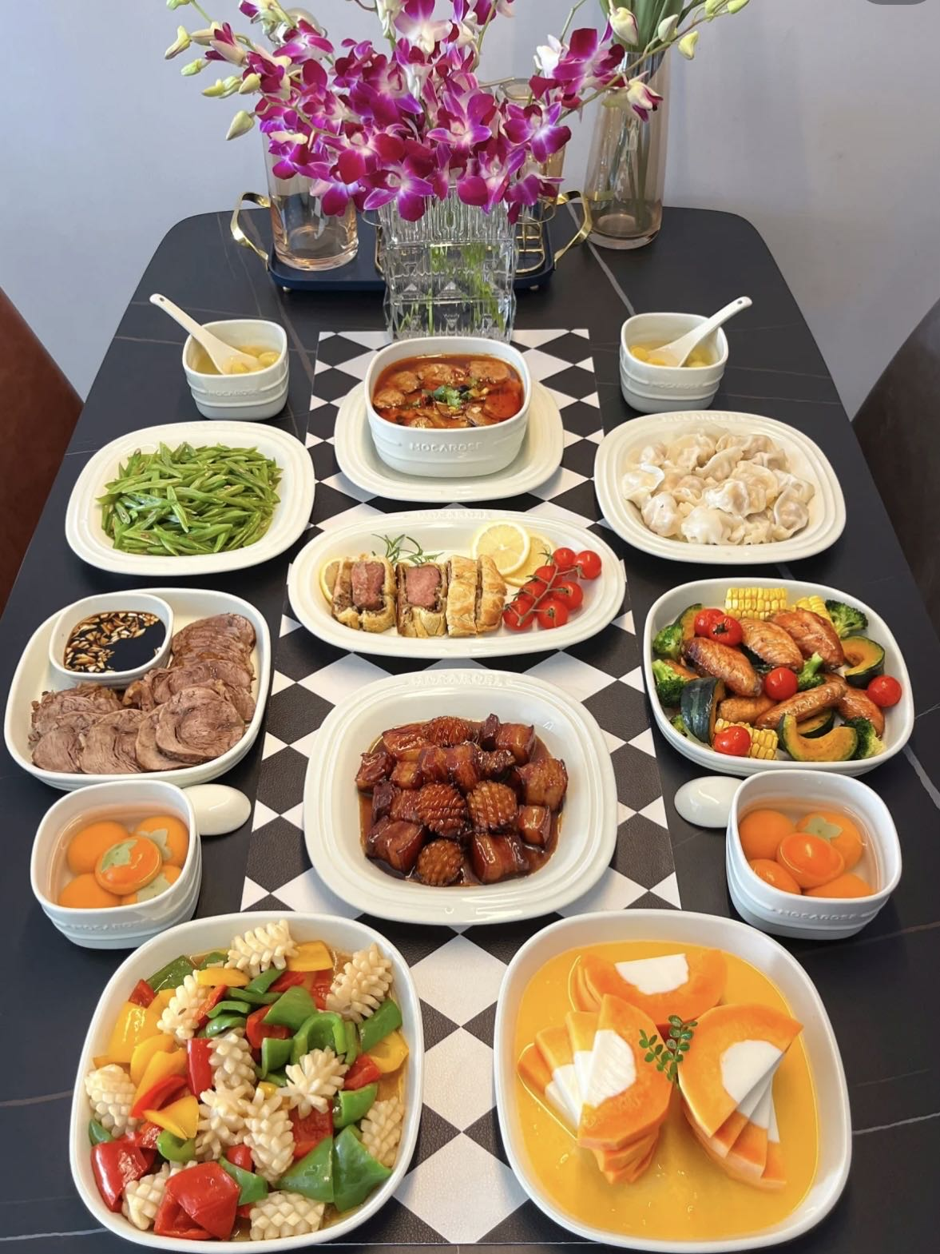

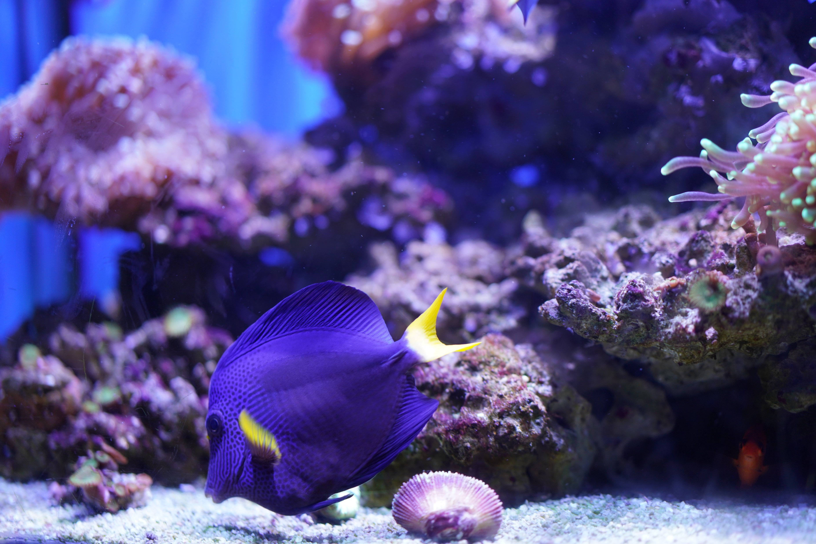
Trivia about me
Favourite Sports: Badminton, Table Tennis, Swimming, Fishing
Admired Musicians: John Williams, Hans Zimmer
Interests: Photography, Sci-fi Movies, Classical Guitar
Note: Avid Participant in Culinary Arts (especially in dish preparation)

Slide 4
Projects I have done
Notes:
An overview

Slide 5
Chinese medicine database
Collected and categorised information on specific Chinese medicines by the developed software.
Realised the automatic analysis function, enabling the experimenter to generate a research report promptly.
Notes:
Have some interfaces.
Led the development and maintenance of the system, implemented with Java and Python.

Slide 6
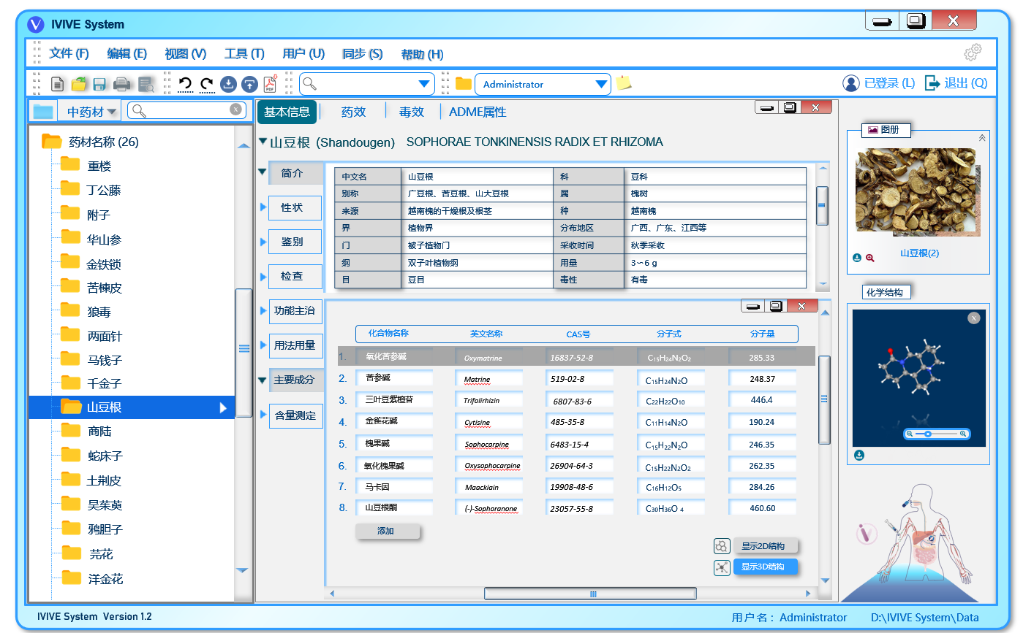
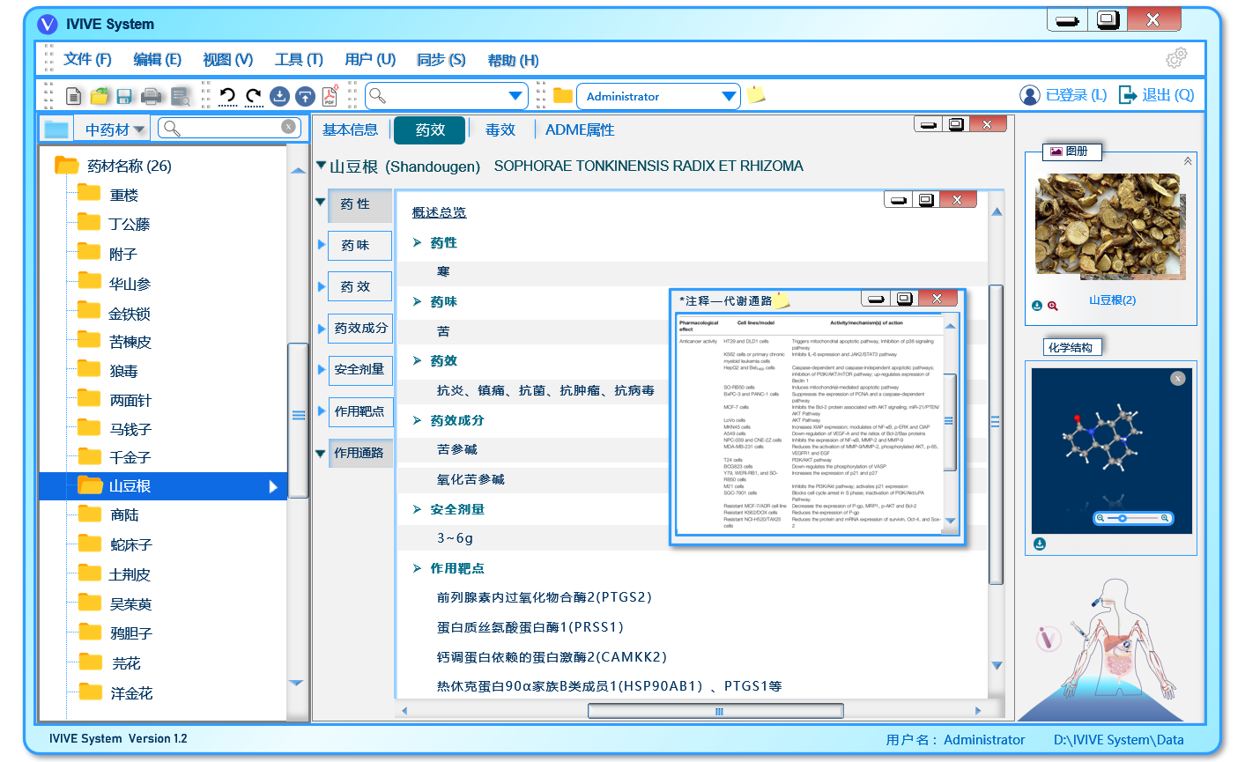
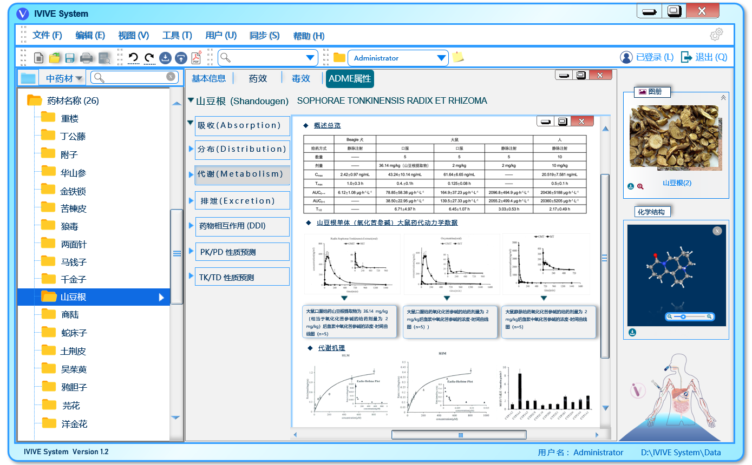
Notes:
Show some basic info, brief, medicinal efficacy, toxicity, ADME properties
In brief, it talks about its taxonomic ranks, distribution, harvest time and dosage
Also some chemical properties

Slide 7
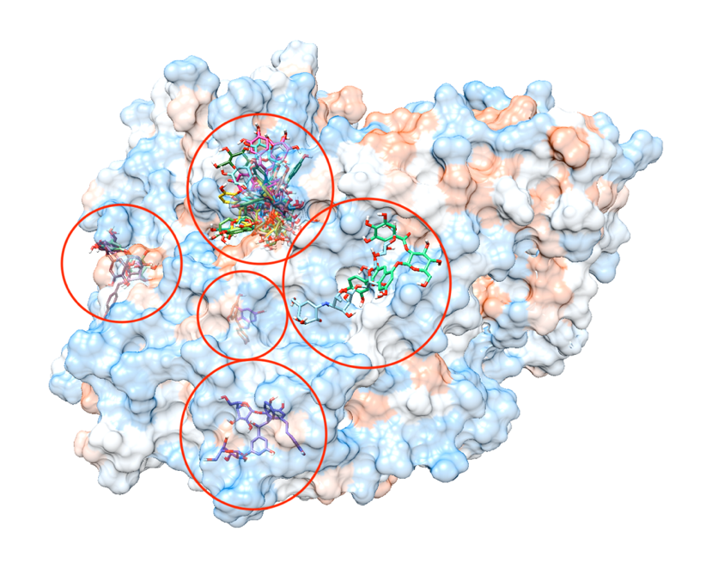
Bioinformatics pipelines
Gene data processing in perl
Blast scripts
Virtual screening

Slide 8
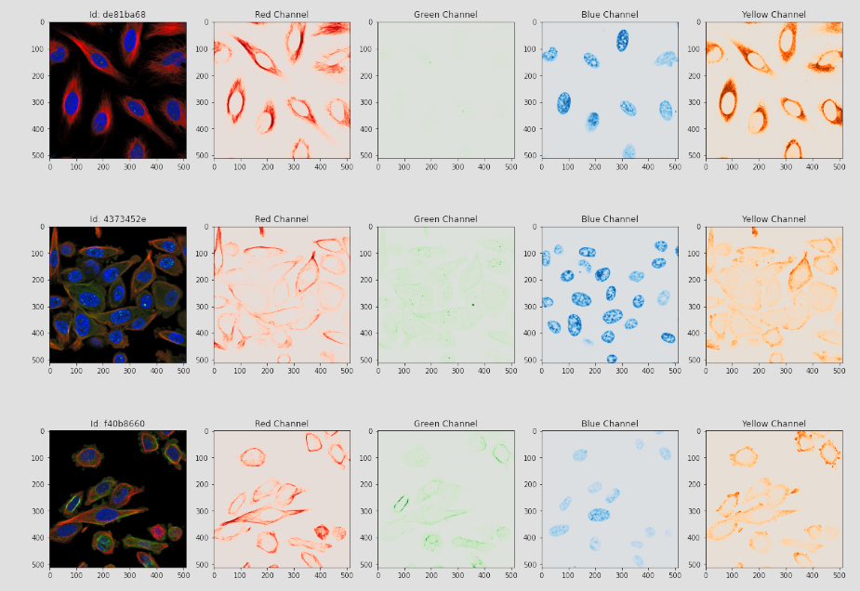
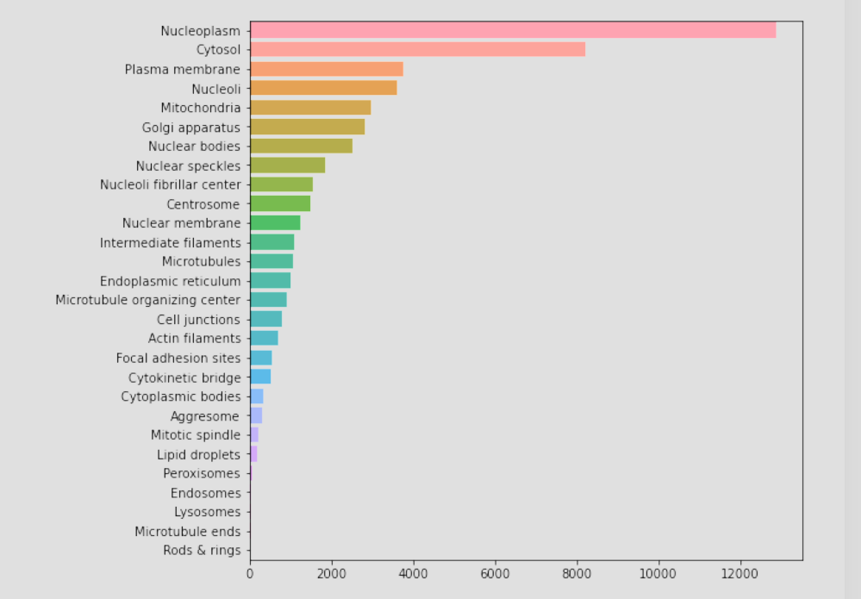
Machine learning
Single cell classification based on human protein altas.
Models for credit default prediction.
Notes:
Four-channel Convolutional neural network model
Unevenly distributed dataset

Slide 9
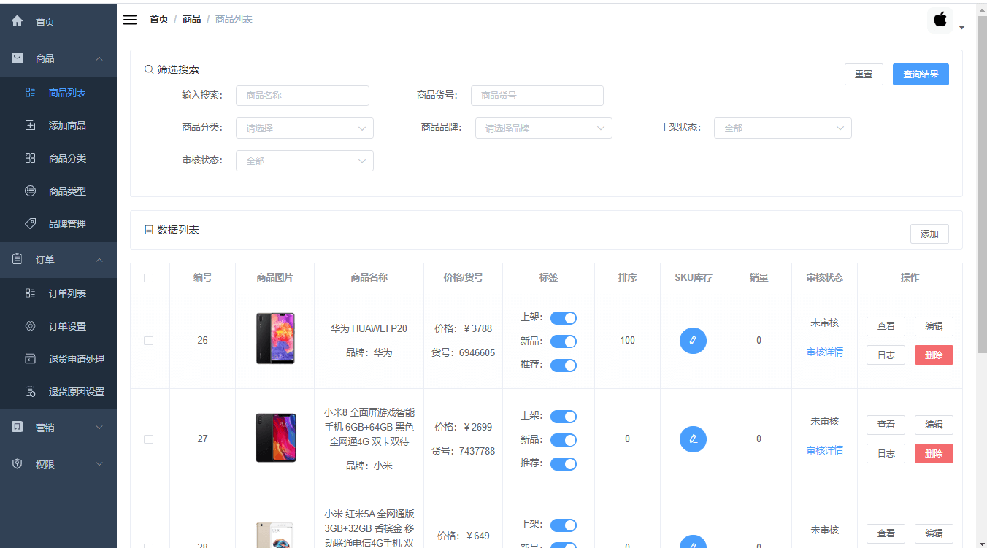
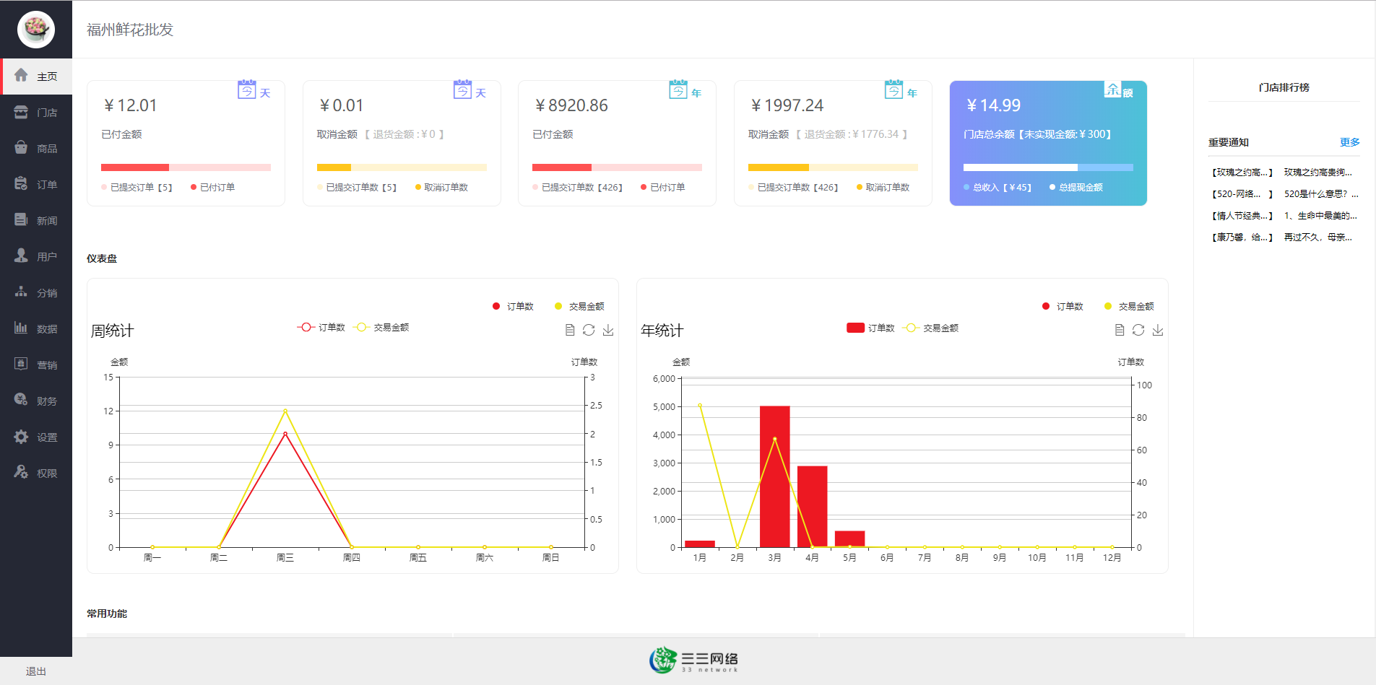
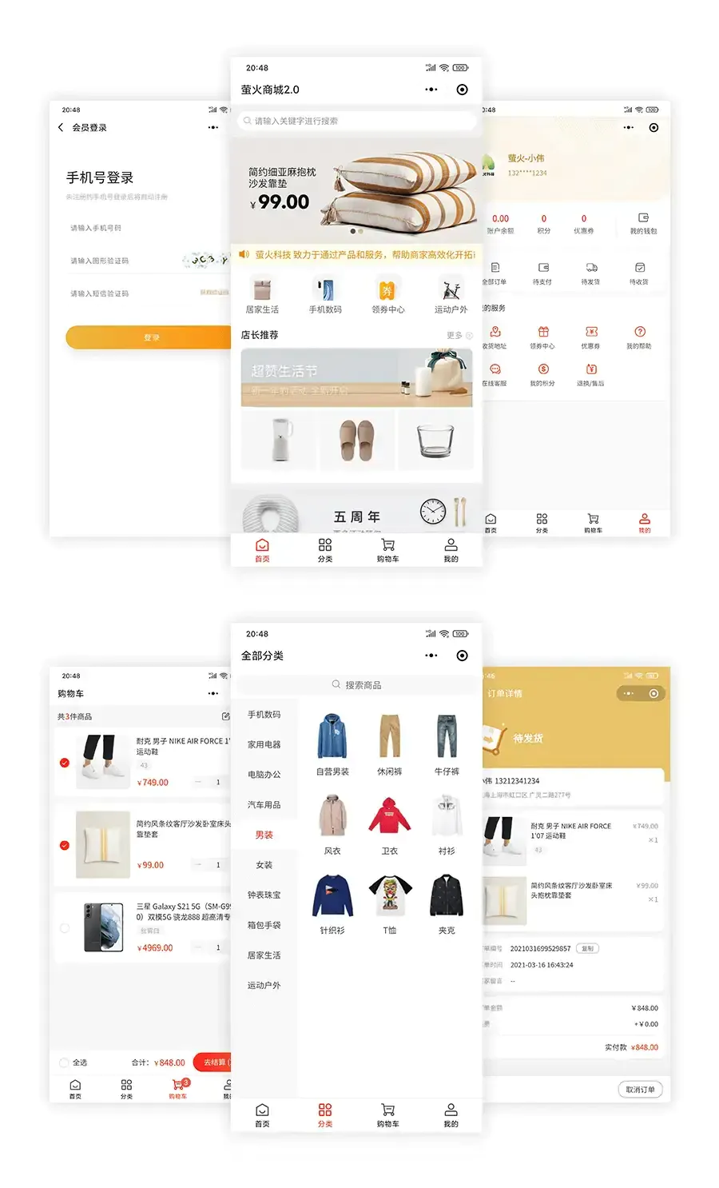
Shopping website and wechat mini program(Evolving from petri dishes to digital carts)
Notes:
Utilised Java, mainly based on SpringBoot, MySQL, MyBatis, and Redis implementation, using B2C mode, SpringMVC three-tier architecture, to develop front and back-end separation.
Realised commodity system, preferential marketing, inventory system, order system, user system, and seckilling function.
Mini program’s interface
Admin system functions like order, inventory management and sales statistics

Slide 10
Current project

Slide 11
Strategies to Improve Adaptation in Plant Breeding with Complex Genotype by Environment Interactions
Supervisors: Dr. Daniel Tolhurst, Prof. Gregor Gorjanc
Presented by: Shuren Xie
Notes:
Hello everyone, my name is Shuren Xie, and here is my research title, Strategies to Improve Adaptation in Plant Breeding with Complex Genotype by Environment Interactions. And I am supervised by Dr. …

Slide 12
Background /Introduction
In the next decades, the agricultural systems will deal with major challenges linked to the expected population growth, climate changes and necessity of sustainable use of resources able to preserve the environment. In this scenario, the development of stable varieties, adapted to various pedoclimatic conditions, marginal habitats and/or low-input farming systems is an imperative target for genetic improvement programs.
Animal and plant breeding is complicated by the fact that individuals respond differently to different environments, a phenomenon known as genotype by environment (G x E) interaction. The G x E analyses have been focused on identifying stable genotypes for crop production.
My masters project will focus on the experimental design of plant breeding trials in the presence of complex G x E interactions.
Notes:
Firstly is the introduction. In the face of population growth, climate change, and the need for sustainable resource use, developing stable crop varieties adaptable to diverse conditions and low-input farming is crucial. The challenge in breeding lies in the genotype by environment (G x E) interaction, which makes some individuals respond differently across environments. Our goal is to identify genotypes that consistently perform well, ensuring food security and environmental preservation.

Slide 13
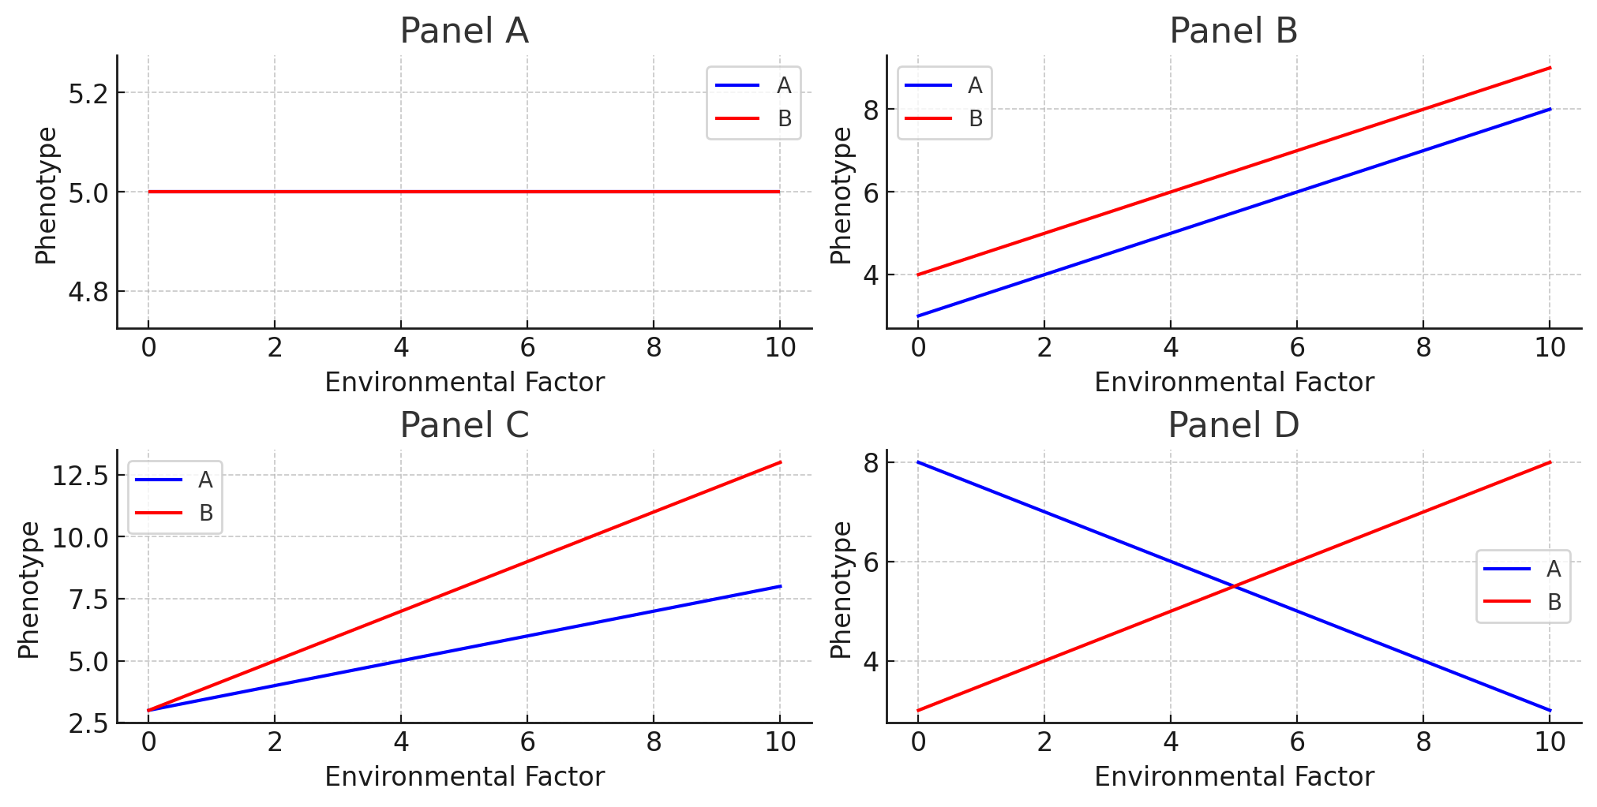
Notes:
generally, A conceptual GXE interaction is depicted as the slope of the line when genotype performance is plotted against an environmental gradient.
Here are some examples of different GxE interactions.
Panel (A) shows that the traits for A and B stay the same, no matter the environment.
Panel (B) has A and B changing the same way as the environment changes. So, no special interaction here.
Panel (C) shows A and B both change as the environment does, but A changes a lot more when things get tougher.
Panel (D) is where A and B switch places in how well they do when the environment changes.

Slide 14
Research question and hypothesis
The aim of this project is to explore different experimental designs that result in better adapted plant varieties for farmers.
We will look at different replication strategies within environments
Randomized Complete Block Design, RCBD e.g., every genotype is grown in every environment the same number of times (typically 2-3 times).
Incomplete block design, IBD e.g., each genotype is grown a different number of times in each environment (some may be grown once, others twice, etc)
We will also look at different replication strategies across environments
Sparse multi-environment design e.g., each genotype is only grown in a subset of environments (this is a type of incomplete block design)
Our aim is to optimise the number of replicates within and across environments, given finite resources
Notes:
And the aim is to explore different replication strategies that result in better adapted plant varieties. And here are some possible strategies.

Slide 15
Data & Processing
Data Simulation
Using R libraries such as FieldSimR and AlphaSimR.
Data Analysis
Linear Mixed Models (LMM)
Use LMM to account for both fixed effects (e.g., genotype, treatments) and random effects (e.g., environmental variation, block effects), isolating the GxE interaction component for each variety.
Basic Machine Learning Models
Apply machine learning models like Random Forests or Support Vector Machines to capture complex, non-linear GxE interactions and predict optimal genotype-environment combinations, using cross-validation for model assessment.
Simulate breeding procedure
Notes:
Let’s talk about how we figure out the best plant varieties for different farms. First, we collect information on how plants grow in various places—how much they produce, how they handle disease, and what their growing conditions are like.
Or we could use generated fake data for model training.
Next, we analyse this with two methods.
One is fitting linear mixed models, which help us find the fixed effects of our plant varieties and treatments from the random noise of environmental variability. This way, we can pinpoint the GxE interactions for each variety with precision.
The other is machine learning, where we employ algorithms like Decision Trees. And these models performs well in discovering the complex, non-linear relationships in our data, allowing us to predict the most resilient genotype-environment combinations. And to ensure our models are robust, we validate them through cross-validation techniques.
And We could also simulate a population with AlphaSimR, incorporating known genetic effects and breeding strategies.
Together, these analytical tools guide us to identify the most adaptable plant varieties for diverse farming conditions.

Slide 16
Skill or Problem sharing ~5 min
What’s new?
How Internet Technology Can Improve Biological Workflows
Notes:
Through long-term practice, I believe that technology itself is cheap, and what matters is how to innovate and complete things successfully (there can be many technical routes)
How to find better strategies in plant breeding projects, such as using machine learning to figure out complex genetic mechanism or reduce tedious work.
Data sharing and collaboration platform: Through the Internet, researchers can easily share and obtain large amounts of biological data. Online databases and sharing platforms make it possible to share everything from genetic sequences to ecological data, which promotes collaboration among global researchers and the rapid spread of knowledge.
Cloud computing and big data analysis: Cloud services provide the necessary computing resources to process large-scale biological data, such as genomics, proteomics data, etc. Machine learning and artificial intelligence algorithms can be used to identify patterns and make predictions, which are critical to understanding complex biological systems.
Remote laboratory management: IoT technology allows researchers to remotely monitor and manage laboratory equipment. For example, they can remotely adjust temperature and humidity or monitor the progress of experiments.
Online experimental design and simulation: Internet technology enables researchers to use online tools to design experiments and conduct pre-simulations, thereby optimizing experimental conditions and improving experimental success rates.
Electronic Laboratory Notebook (ELN): Electronic experimental records replace traditional paper experimental notebooks, improving the accuracy, searchability and shareability of data records.
BUT, would it be hard to deploy them, or are they as efficient as we suppose them to be?

